Slide 1
FULLY OPEN SOURCE DATA DASHBOARDS WITH R
bit.ly/rss-2022_cjh
Charlotte Hadley
@charliejhadley

Slide 2




Quarto
{htmlwidgets}
{shiny}
Notes:
There are three questions you need to answer to successfully build a useful map.
Firstly – where is the data?
How does the data vary?
And finally – where is the data geographically? That is a different question from the first one – we’ll see why in a few minutes.

Slide 3

Quarto
Quarto allows us to build:
Interactive reports and slides
Static reports and slides (PDF, MS Word and PowerPoint)
Entire websites
Quarto allows us to build using either of these languages:
R
Python
Julia
Notes:
Thanks for coming to this Introduction to Mapping session.
Like all of our “Introduction to X” sessions this is a 30minute session designed to help you understand if a specific skill or tool would be useful for you – or for your team.
We also want to show you what it’s possible to make with this skill – so I’m going to show you different examples of maps and how they might fit into your business (or data) needs
... These introduction sessions are designed to be booked separately to the hands on session to give you enough time to gather the data that you’d need to apply the skill to what you need to do. In terms of mapping this is very important and you might want to talk to us about how to collect the relevant data.
… but of course the data academy is also about offering you training and development that you might find interesting… I really enjoy making maps and I think they can be really useful – which hopefully you’ll take away from this session.

Slide 4
Quarto
Quarto allows us to build:
Interactive reports and slides
Static reports and slides (PDF, MS Word and PowerPoint)
Entire websites
Quarto allows us to build using either of these languages:
R
Python
Julia
Quarto is the next evolution of RMarkdown
Notes:
Thanks for coming to this Introduction to Mapping session.
Like all of our “Introduction to X” sessions this is a 30minute session designed to help you understand if a specific skill or tool would be useful for you – or for your team.
We also want to show you what it’s possible to make with this skill – so I’m going to show you different examples of maps and how they might fit into your business (or data) needs
... These introduction sessions are designed to be booked separately to the hands on session to give you enough time to gather the data that you’d need to apply the skill to what you need to do. In terms of mapping this is very important and you might want to talk to us about how to collect the relevant data.
… but of course the data academy is also about offering you training and development that you might find interesting… I really enjoy making maps and I think they can be really useful – which hopefully you’ll take away from this session.

Slide 5
Quarto
{htmlwidgets}
{shiny}
Notes:
There are three questions you need to answer to successfully build a useful map.
Firstly – where is the data?
How does the data vary?
And finally – where is the data geographically? That is a different question from the first one – we’ll see why in a few minutes.

Slide 6
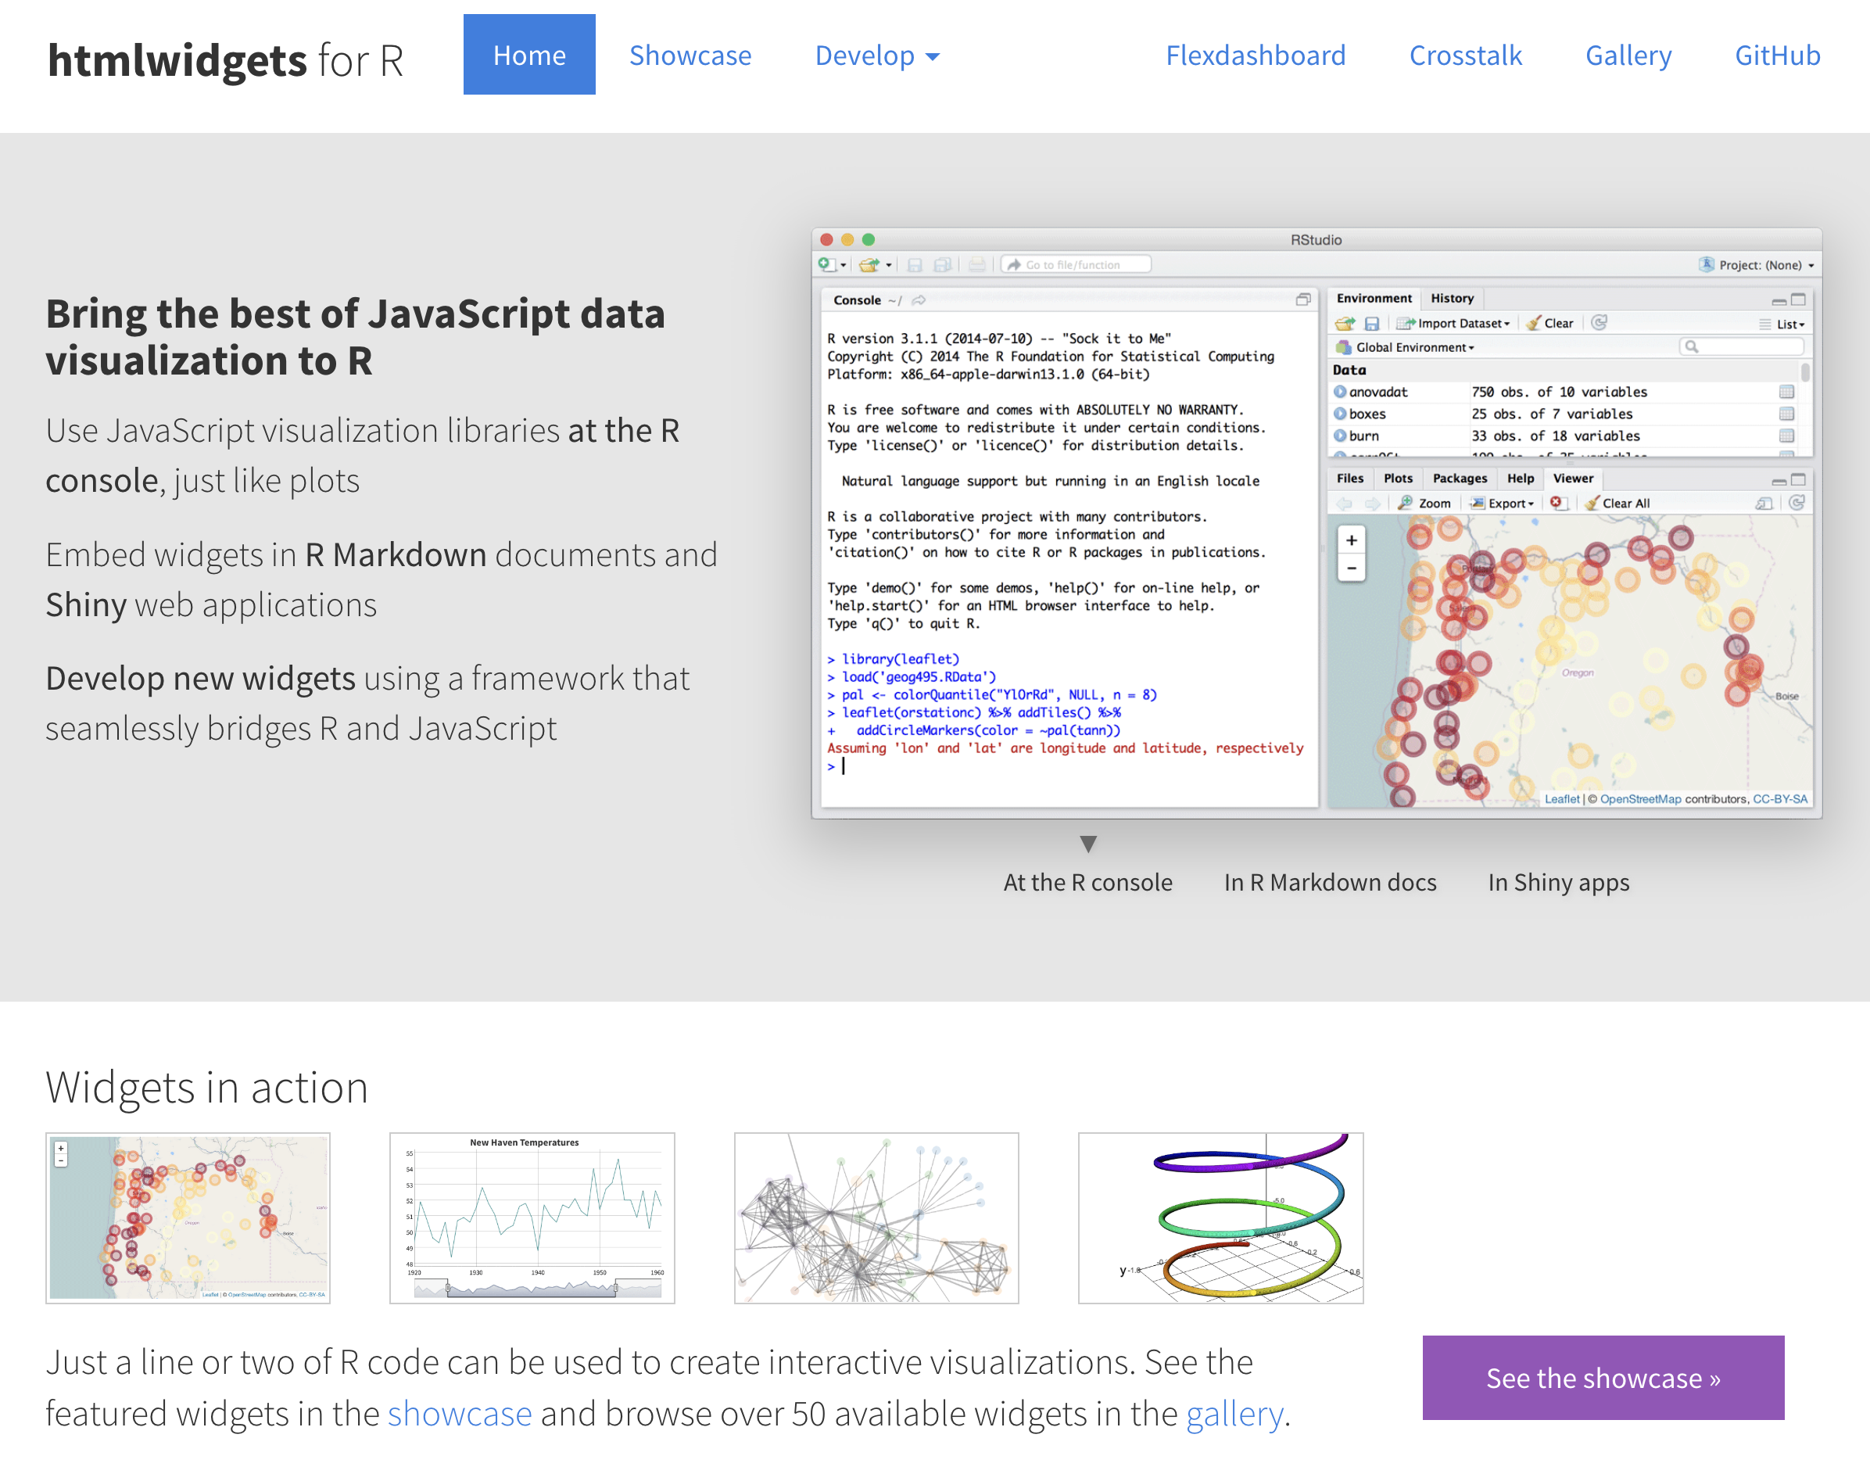

Slide 7
Quarto
{htmlwidgets}
{shiny}
Doesn’t require a server – everything happens in the browser
Notes:
There are three questions you need to answer to successfully build a useful map.
Firstly – where is the data?
How does the data vary?
And finally – where is the data geographically? That is a different question from the first one – we’ll see why in a few minutes.

Slide 8

Quarto
{htmlwidgets}
{shiny}
Needs a server
Notes:
There are three questions you need to answer to successfully build a useful map.
Firstly – where is the data?
How does the data vary?
And finally – where is the data geographically? That is a different question from the first one – we’ll see why in a few minutes.

Slide 9
{shiny} for R
{shiny} is a framework for building web apps dashboards with R.
We write the UX with R code.
We write the server side of the code with R.
Notes:
Thanks for coming to this Introduction to Mapping session.
Like all of our “Introduction to X” sessions this is a 30minute session designed to help you understand if a specific skill or tool would be useful for you – or for your team.
We also want to show you what it’s possible to make with this skill – so I’m going to show you different examples of maps and how they might fit into your business (or data) needs
... These introduction sessions are designed to be booked separately to the hands on session to give you enough time to gather the data that you’d need to apply the skill to what you need to do. In terms of mapping this is very important and you might want to talk to us about how to collect the relevant data.
… but of course the data academy is also about offering you training and development that you might find interesting… I really enjoy making maps and I think they can be really useful – which hopefully you’ll take away from this session.

Slide 10
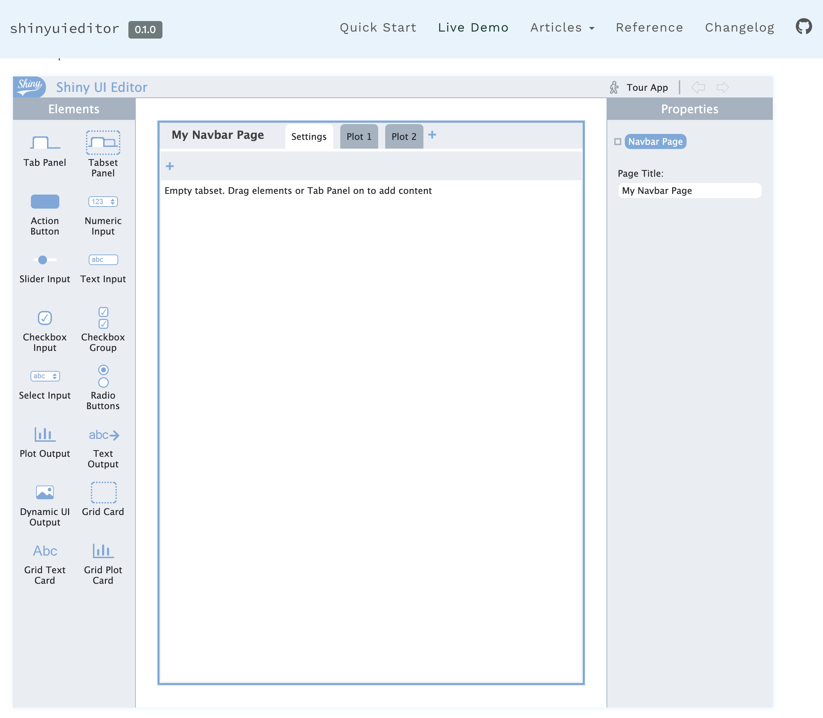
A beta tool for building {shiny} GUI
Notes:
Maps are really useful because they give us context to geographic information.
If we want to understand where our offices – or our customers – are based, a map is the best choice.

Slide 11



Commercially licensed CMS for Shiny apps
Hosted for you
Self-hosted
Notes:
There are three questions you need to answer to successfully build a useful map.
Firstly – where is the data?
How does the data vary?
And finally – where is the data geographically? That is a different question from the first one – we’ll see why in a few minutes.

Slide 12

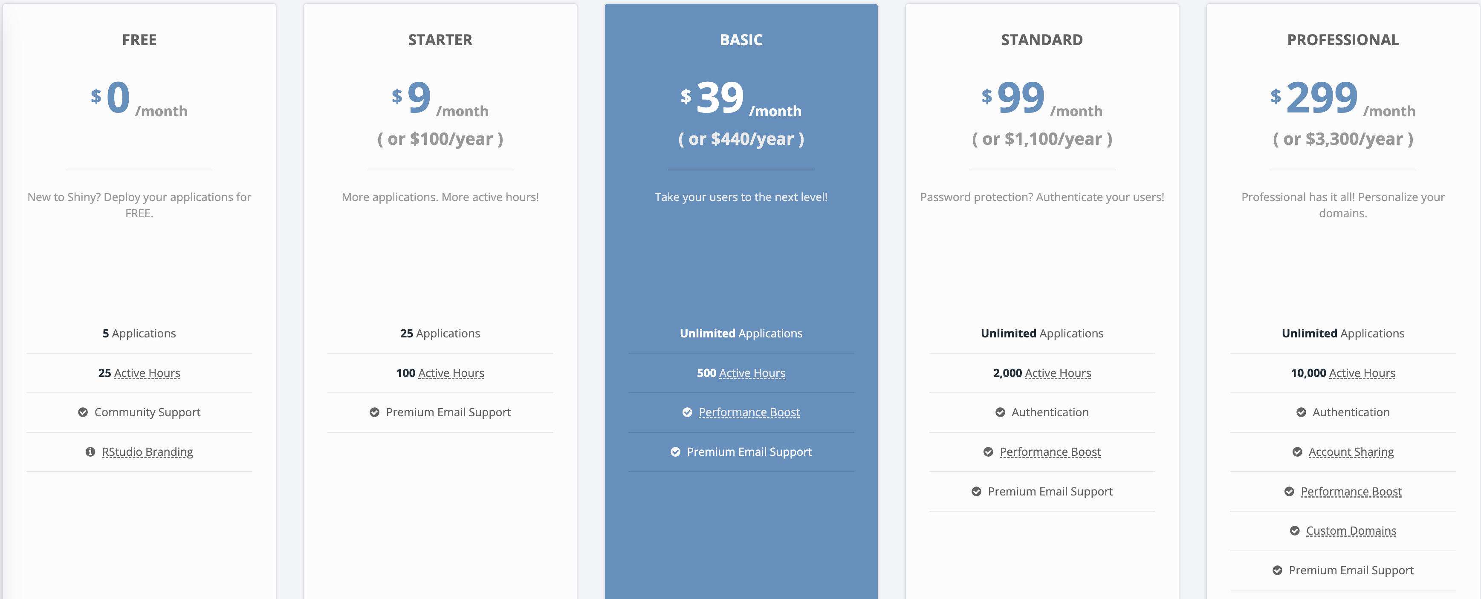

Slide 13
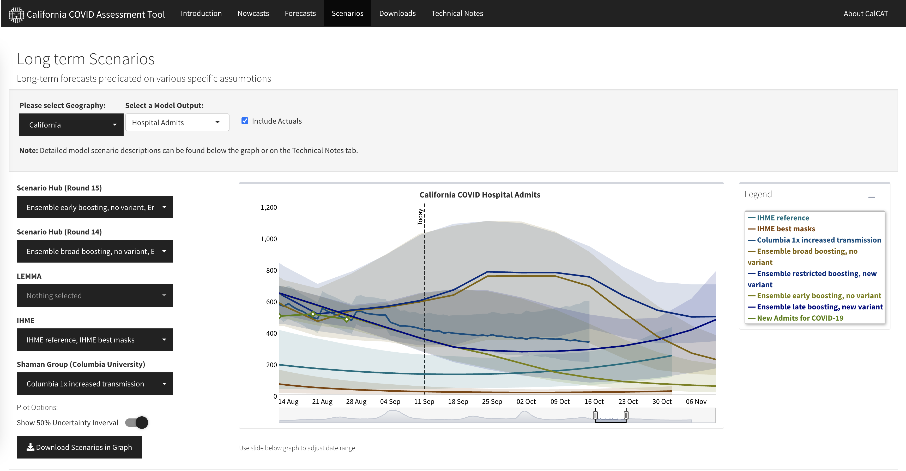
{shiny} in production

Slide 14
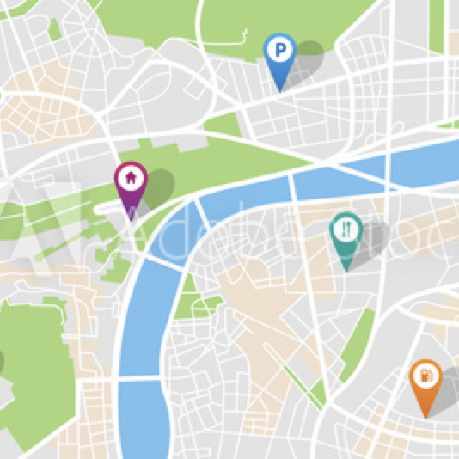
Features for shiny apps
Manage user access to shiny apps
Manage admin rights to shiny apps
Manage server resources
Notes:
Thanks for coming to this Introduction to Mapping session.
Like all of our “Introduction to X” sessions this is a 30minute session designed to help you understand if a specific skill or tool would be useful for you – or for your team.
We also want to show you what it’s possible to make with this skill – so I’m going to show you different examples of maps and how they might fit into your business (or data) needs
... These introduction sessions are designed to be booked separately to the hands on session to give you enough time to gather the data that you’d need to apply the skill to what you need to do. In terms of mapping this is very important and you might want to talk to us about how to collect the relevant data.
… but of course the data academy is also about offering you training and development that you might find interesting… I really enjoy making maps and I think they can be really useful – which hopefully you’ll take away from this session.

Slide 15
Features for shiny apps
Manage user access to shiny apps
Manage admin rights to shiny apps
Manage server resources
For RMarkdown & Quarto aps
Manage access to shiny apps
Programmatically run reports by schedule or a trigger
Notes:
Thanks for coming to this Introduction to Mapping session.
Like all of our “Introduction to X” sessions this is a 30minute session designed to help you understand if a specific skill or tool would be useful for you – or for your team.
We also want to show you what it’s possible to make with this skill – so I’m going to show you different examples of maps and how they might fit into your business (or data) needs
... These introduction sessions are designed to be booked separately to the hands on session to give you enough time to gather the data that you’d need to apply the skill to what you need to do. In terms of mapping this is very important and you might want to talk to us about how to collect the relevant data.
… but of course the data academy is also about offering you training and development that you might find interesting… I really enjoy making maps and I think they can be really useful – which hopefully you’ll take away from this session.

Slide 16

Features for shiny apps
Manage user access to shiny apps
Manage admin rights to shiny apps
Manage server resources
For RMarkdown & Quarto aps
Manage access to shiny apps
Programmatically run reports by schedule or a trigger
For hosting R API
Create from R code using {plumber}
Notes:
Thanks for coming to this Introduction to Mapping session.
Like all of our “Introduction to X” sessions this is a 30minute session designed to help you understand if a specific skill or tool would be useful for you – or for your team.
We also want to show you what it’s possible to make with this skill – so I’m going to show you different examples of maps and how they might fit into your business (or data) needs
... These introduction sessions are designed to be booked separately to the hands on session to give you enough time to gather the data that you’d need to apply the skill to what you need to do. In terms of mapping this is very important and you might want to talk to us about how to collect the relevant data.
… but of course the data academy is also about offering you training and development that you might find interesting… I really enjoy making maps and I think they can be really useful – which hopefully you’ll take away from this session.

Slide 17
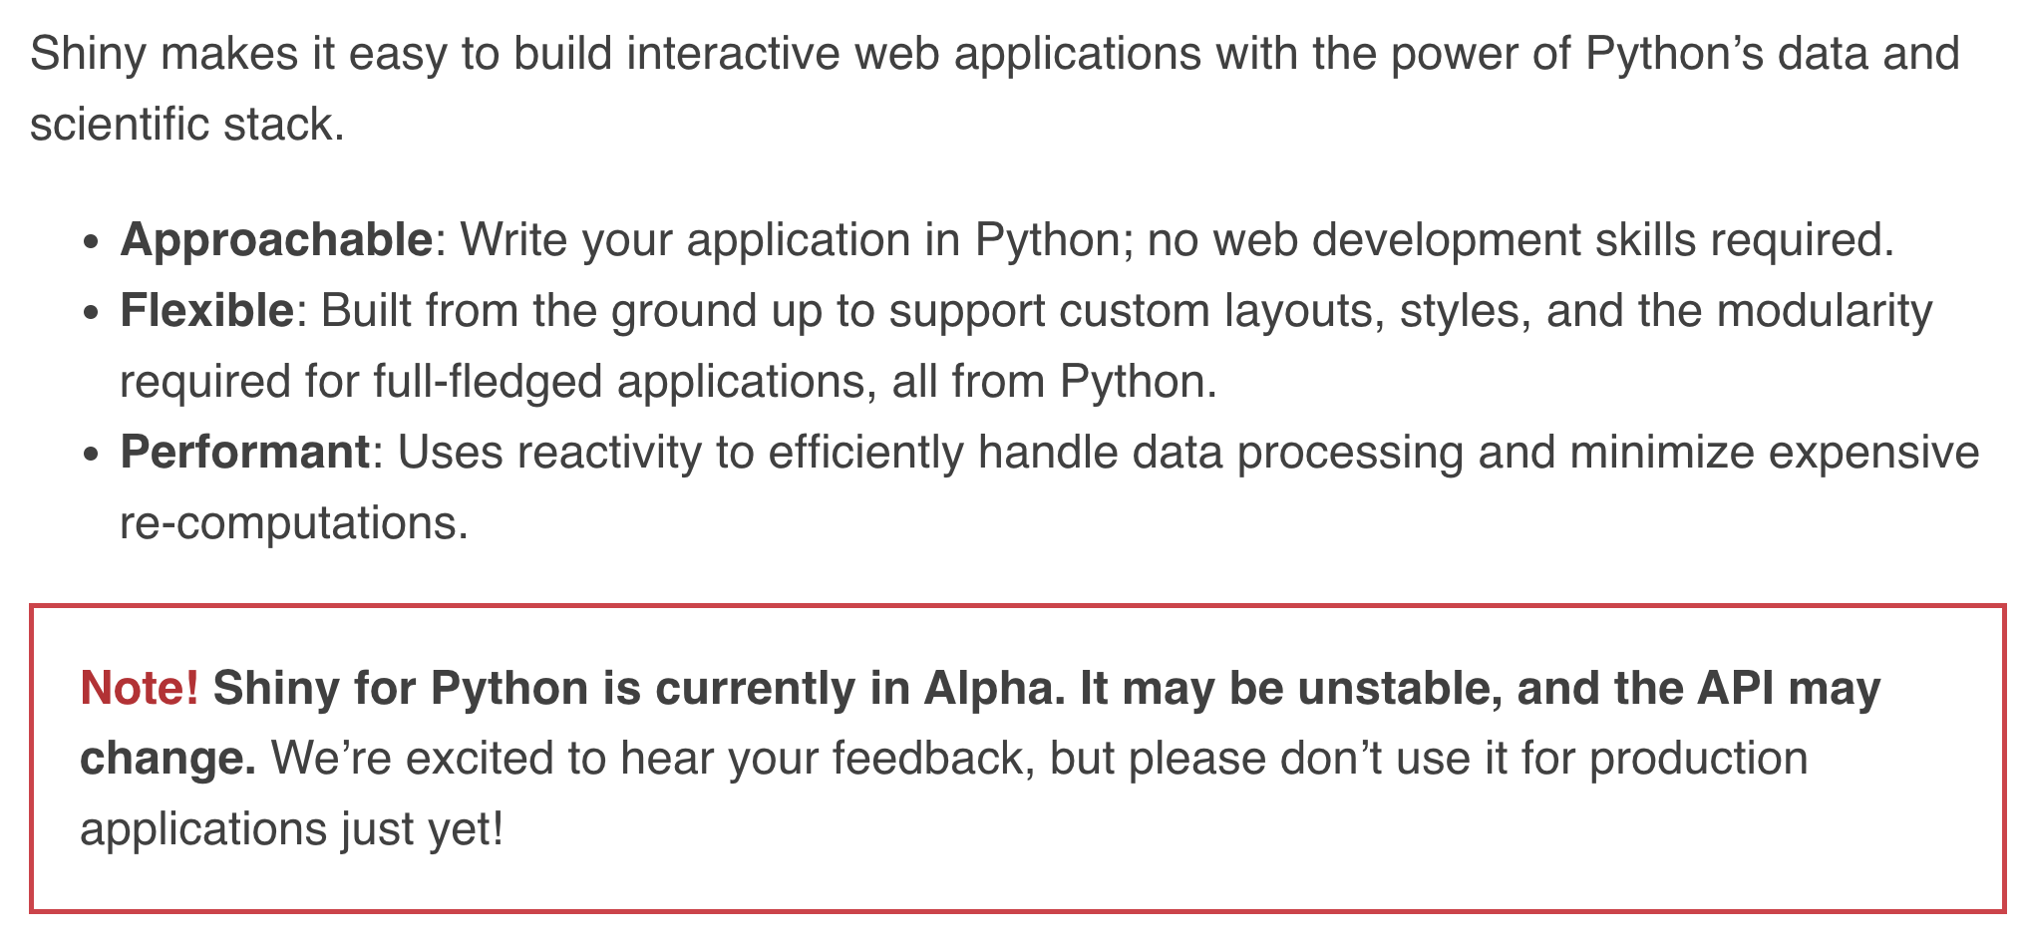
shiny for Python!
shiny.rstudio.com/py
Notes:
Thanks for coming to this Introduction to Mapping session.
Like all of our “Introduction to X” sessions this is a 30minute session designed to help you understand if a specific skill or tool would be useful for you – or for your team.
We also want to show you what it’s possible to make with this skill – so I’m going to show you different examples of maps and how they might fit into your business (or data) needs
... These introduction sessions are designed to be booked separately to the hands on session to give you enough time to gather the data that you’d need to apply the skill to what you need to do. In terms of mapping this is very important and you might want to talk to us about how to collect the relevant data.
… but of course the data academy is also about offering you training and development that you might find interesting… I really enjoy making maps and I think they can be really useful – which hopefully you’ll take away from this session.

Slide 18
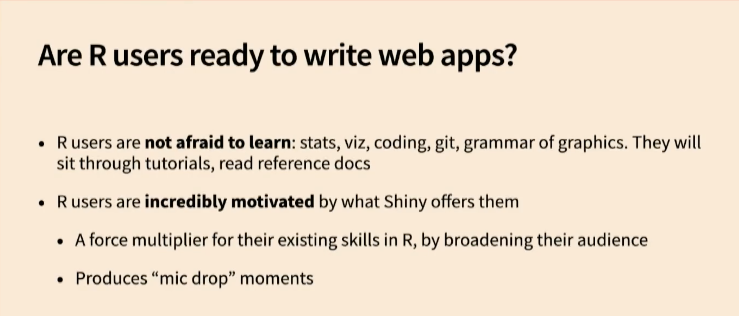

rstudio::conf(2022)
The Past and Future of Shiny
Joe Cheng
rstudio.com/conference/2022/keynotes/past-future-shiny
Notes:
Thanks for coming to this Introduction to Mapping session.
Like all of our “Introduction to X” sessions this is a 30minute session designed to help you understand if a specific skill or tool would be useful for you – or for your team.
We also want to show you what it’s possible to make with this skill – so I’m going to show you different examples of maps and how they might fit into your business (or data) needs
... These introduction sessions are designed to be booked separately to the hands on session to give you enough time to gather the data that you’d need to apply the skill to what you need to do. In terms of mapping this is very important and you might want to talk to us about how to collect the relevant data.
… but of course the data academy is also about offering you training and development that you might find interesting… I really enjoy making maps and I think they can be really useful – which hopefully you’ll take away from this session.

